Slide 1
Citrus Dataset (Immature)

Slide 2
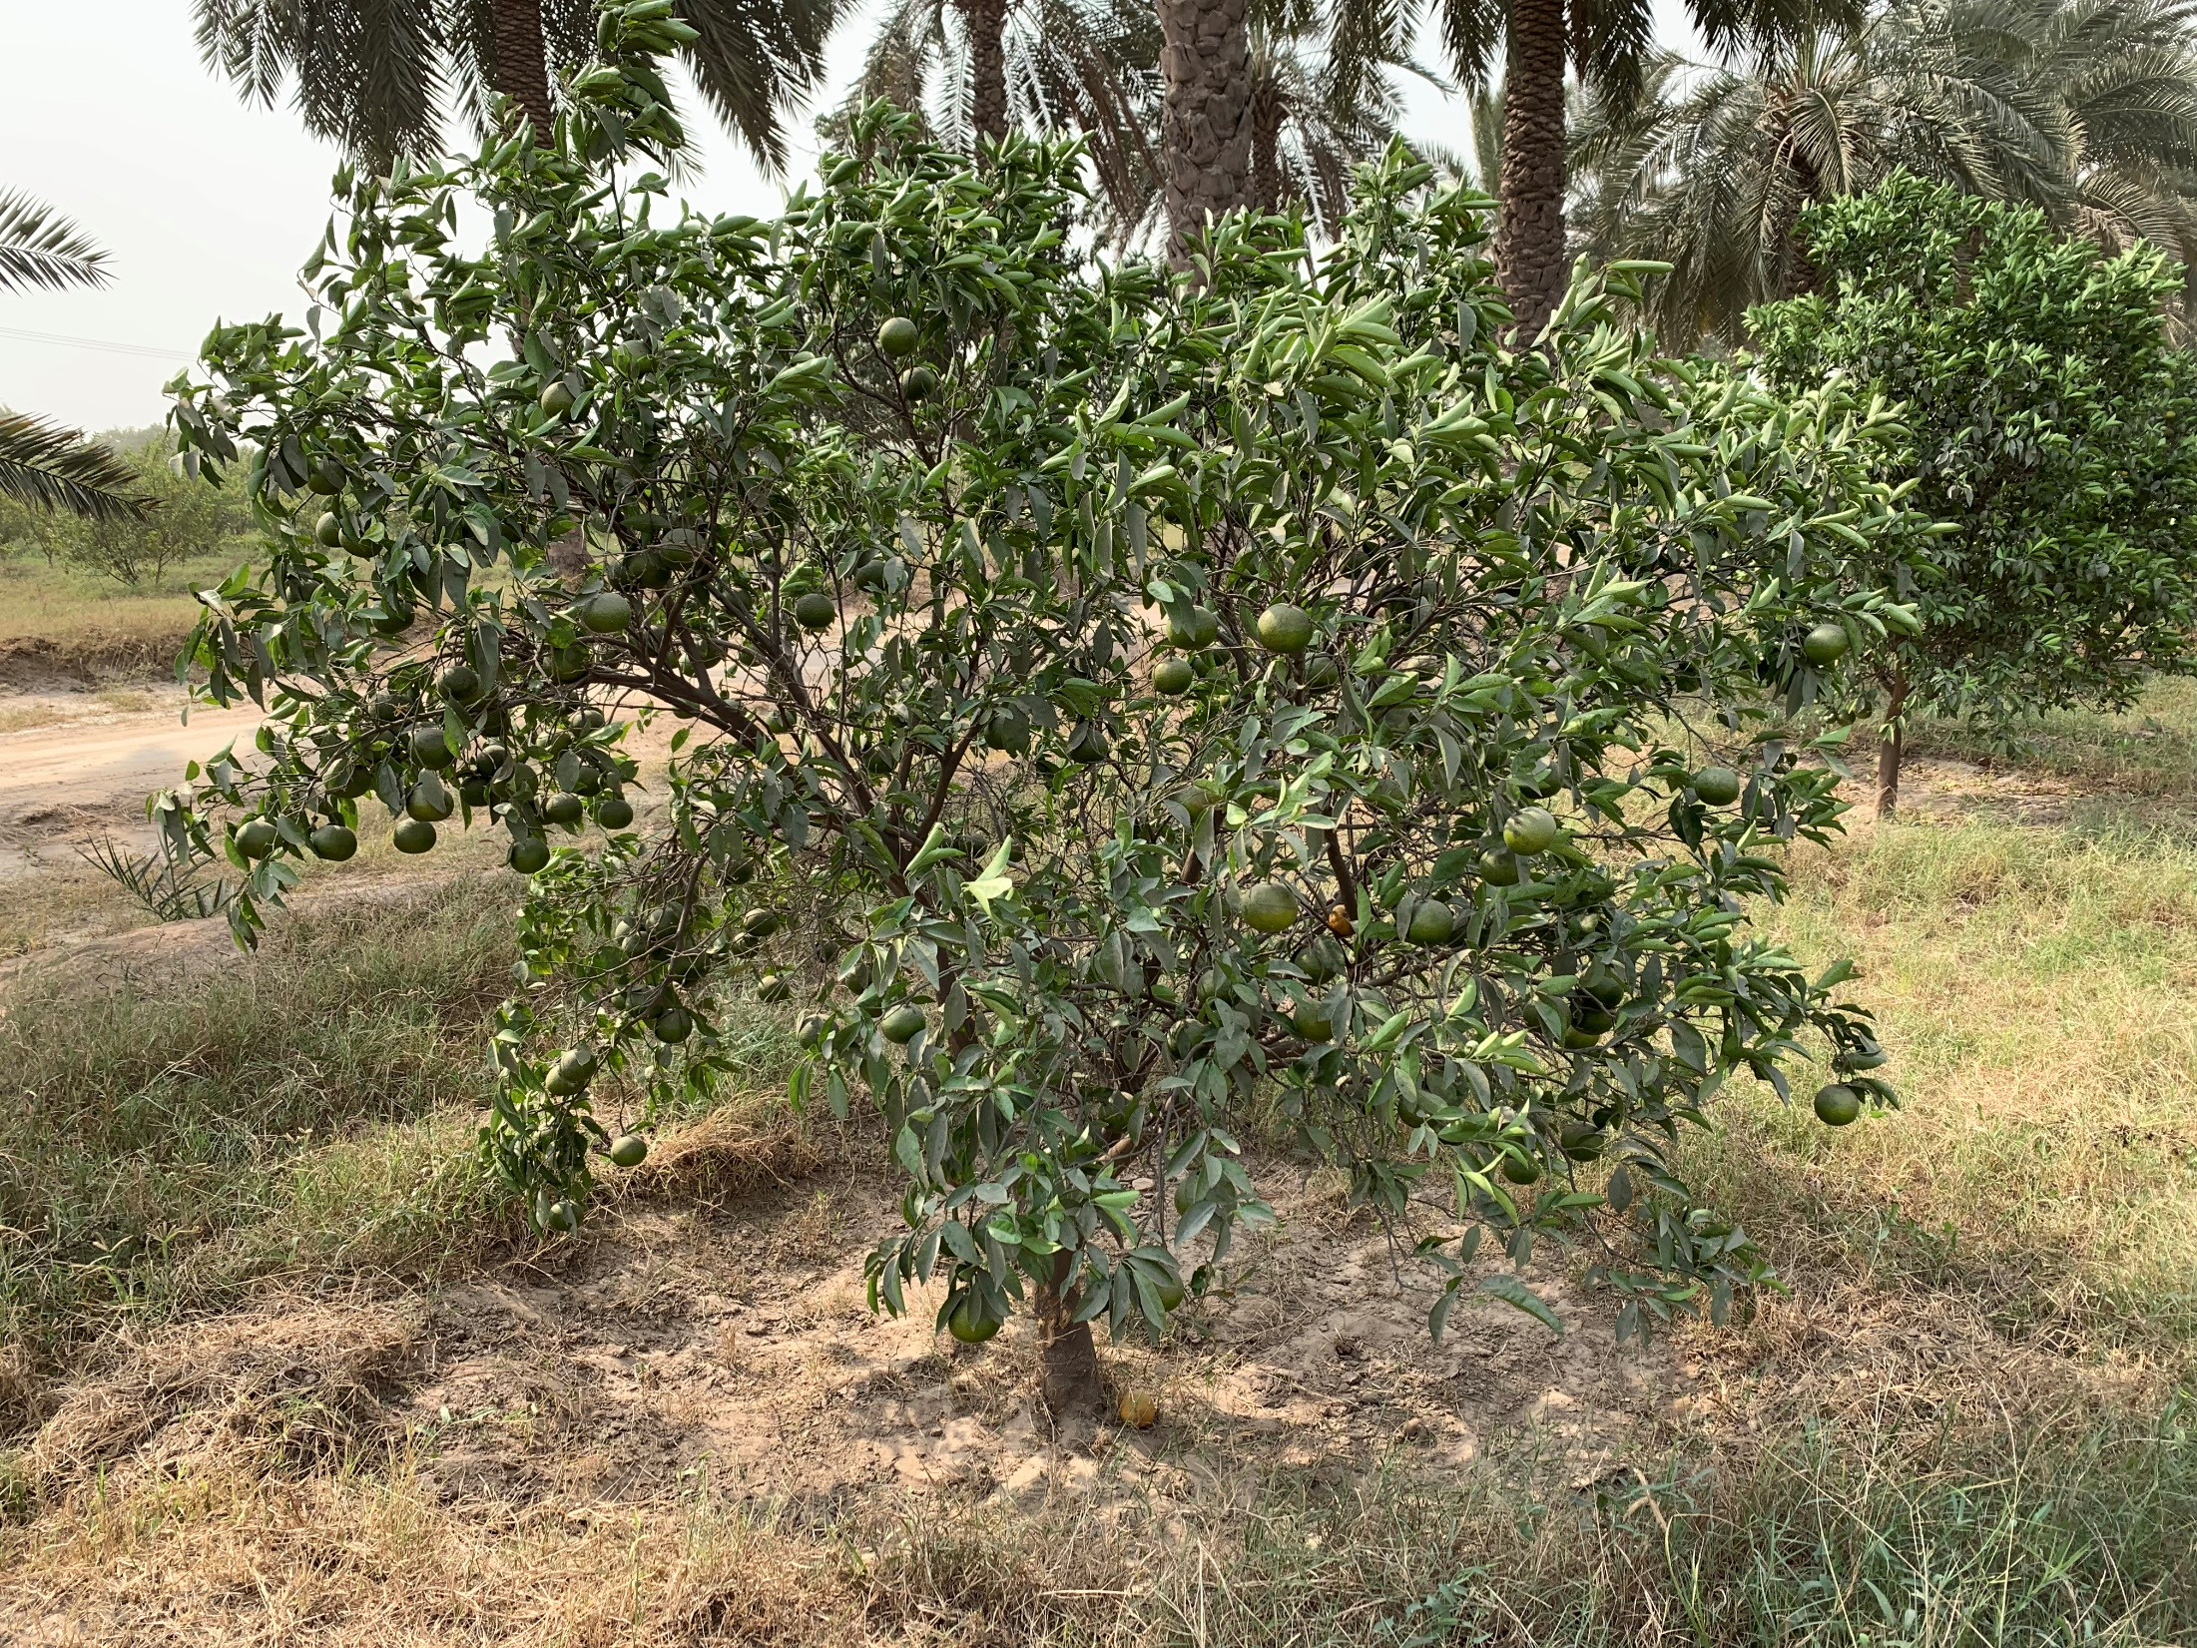
Tree’s (5 trees)
Tree 1
Side 1

Slide 3
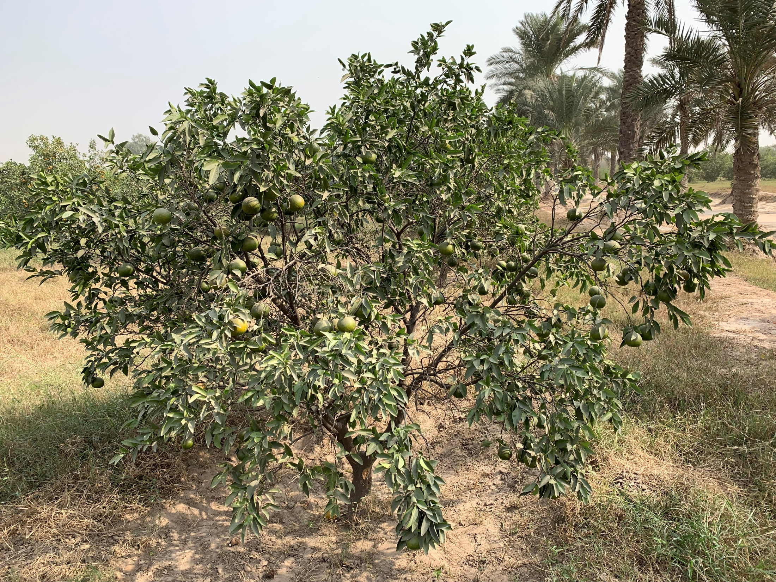
Tree 1
Side 2

Slide 4
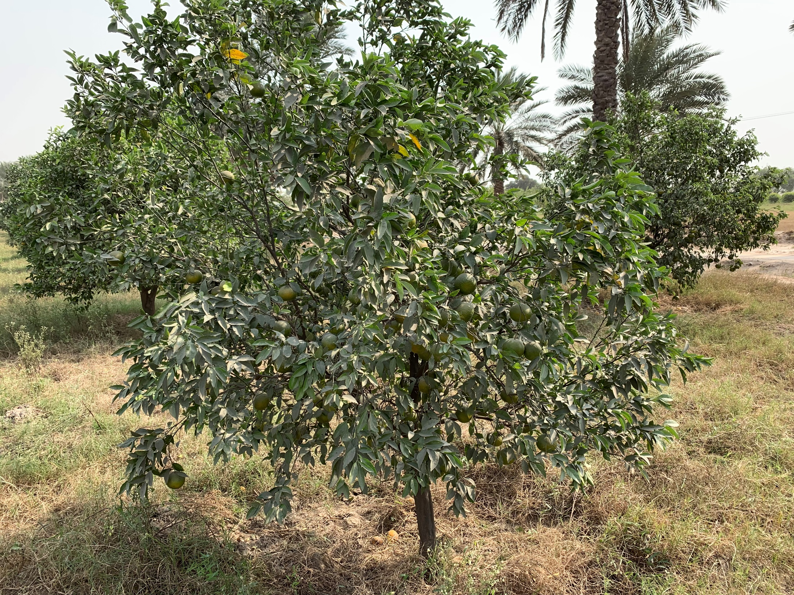
Tree 2
Side 1

Slide 5
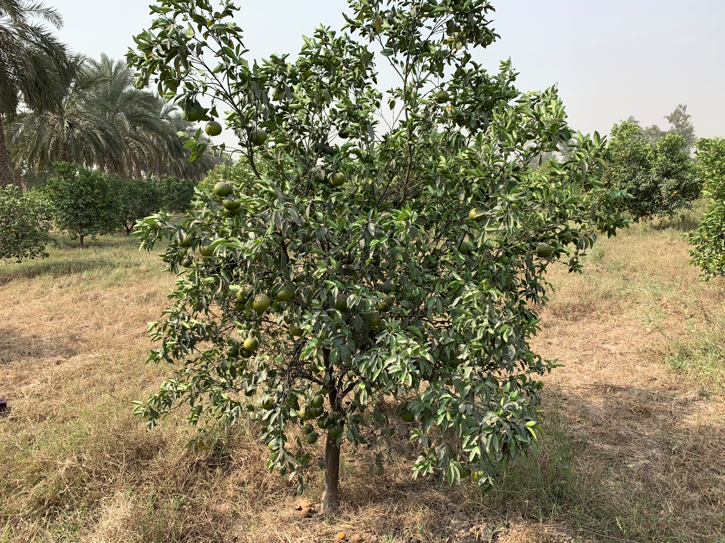
Tree 2
Side 2

Slide 6
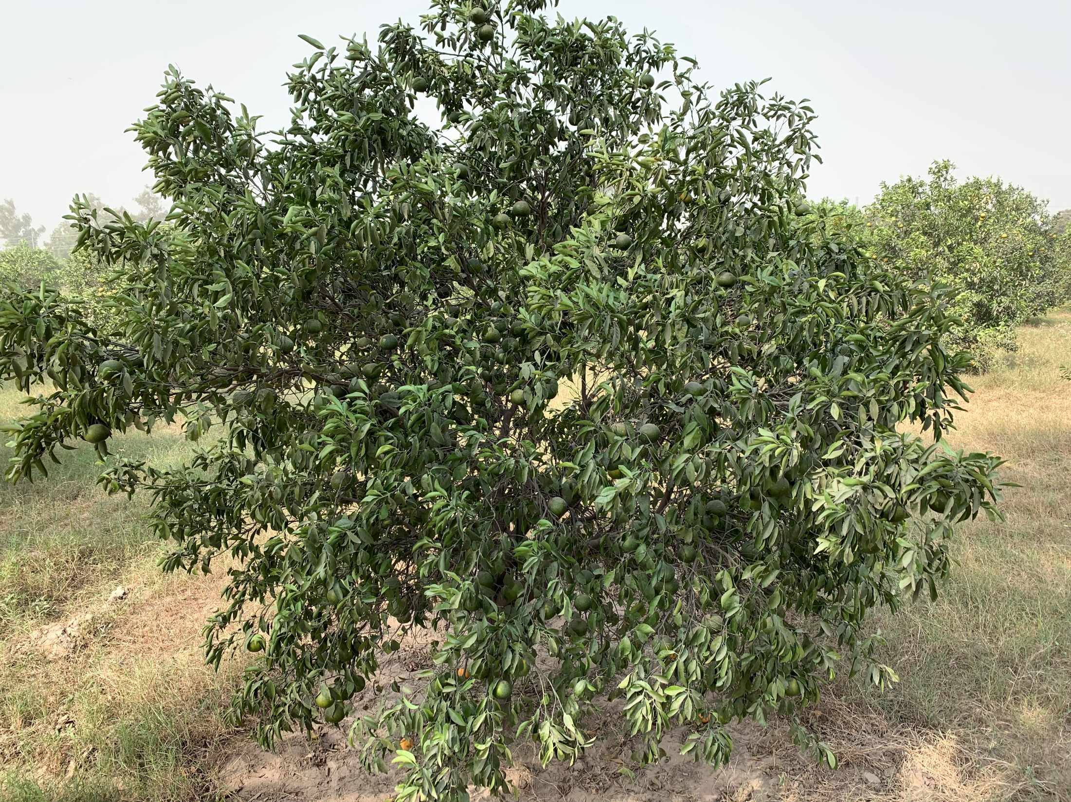
Tree 3
Side 1

Slide 7
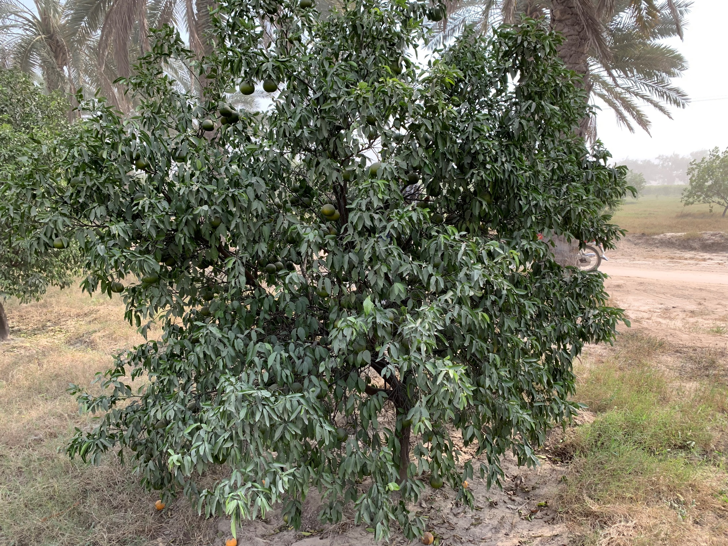
Tree 3
Side 2

Slide 8
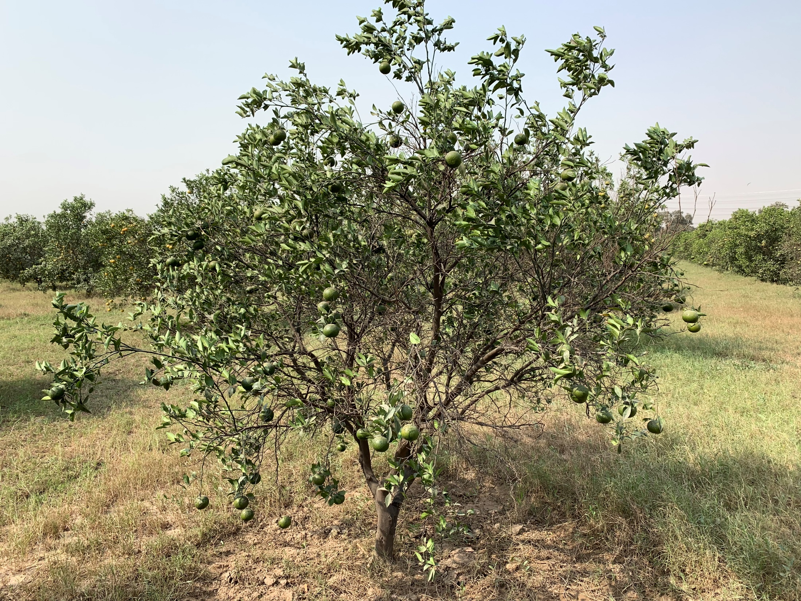
Tree 4
Side 1

Slide 9
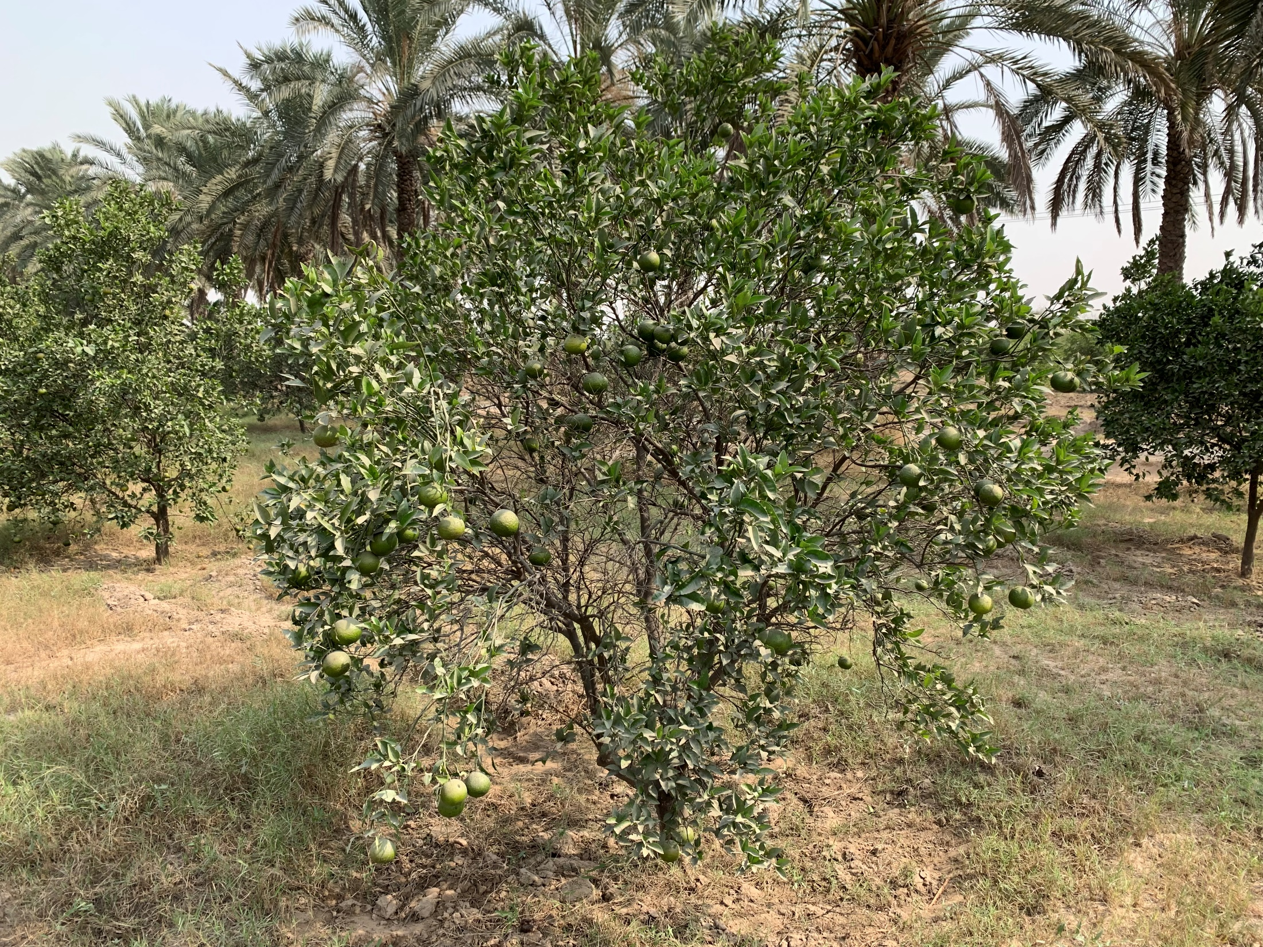
Tree 4
Side 2

Slide 10
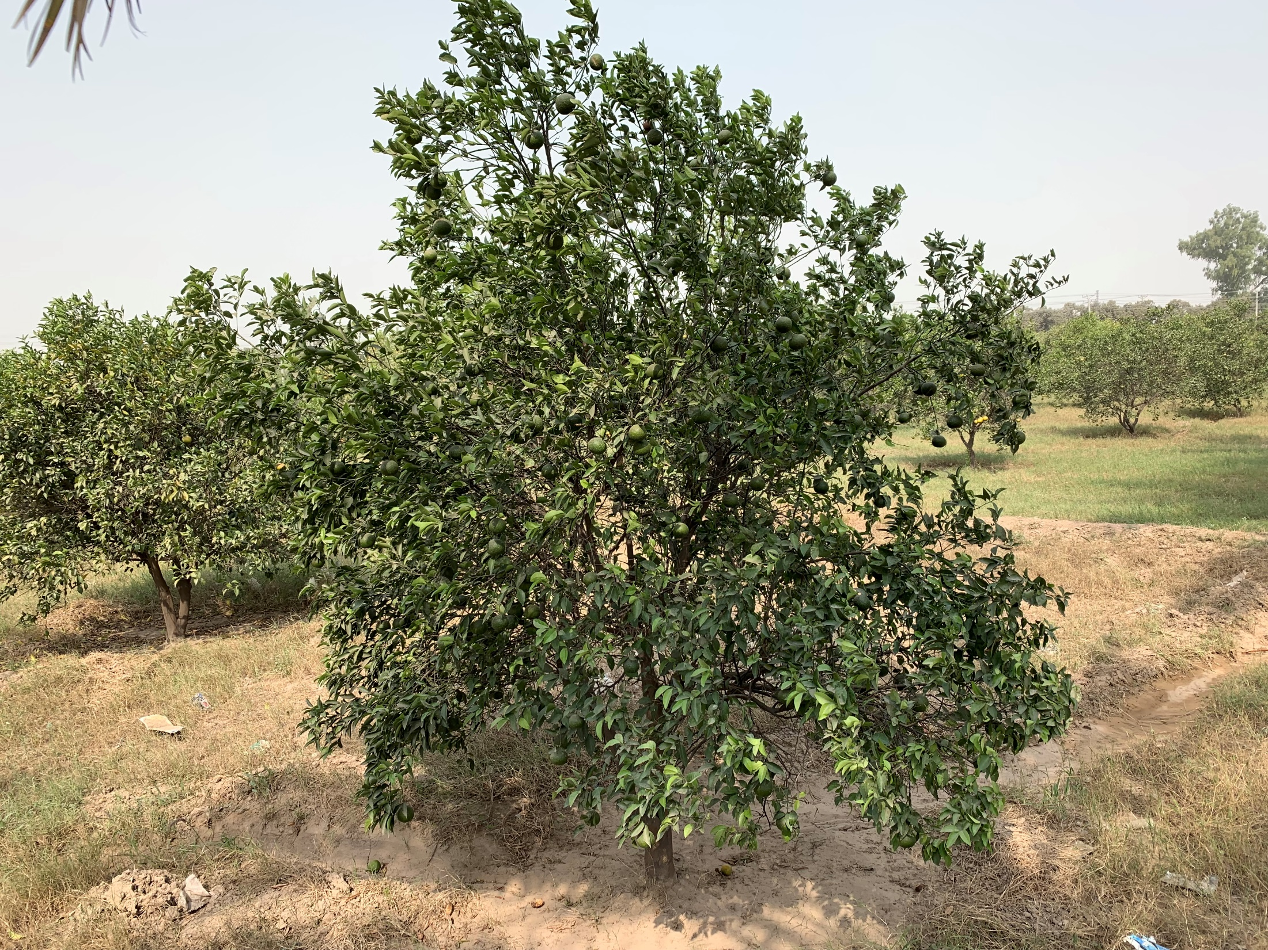
Tree 5
Side 1

Slide 11
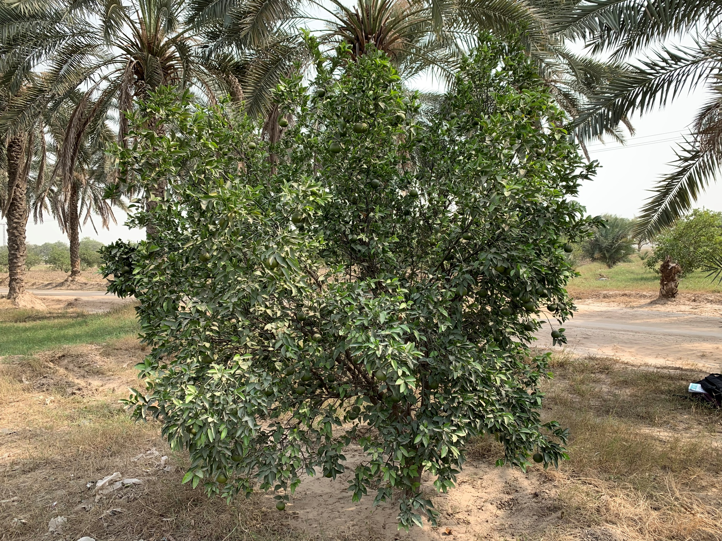
Tree 5
Side 2

Slide 12
Tree No | Ground Truth Values | Annotated Images value
1 | 170 – 190 | 216
2 | 150 – 160 | 129
3 | 320 – 350 | 242
4 | 145 – 165 | 148
5 | 240 – 260 | 208

